Slide 1

Motorized Cart Safety Course
Presented by the Office of Environmental Health and Safety

Slide 2
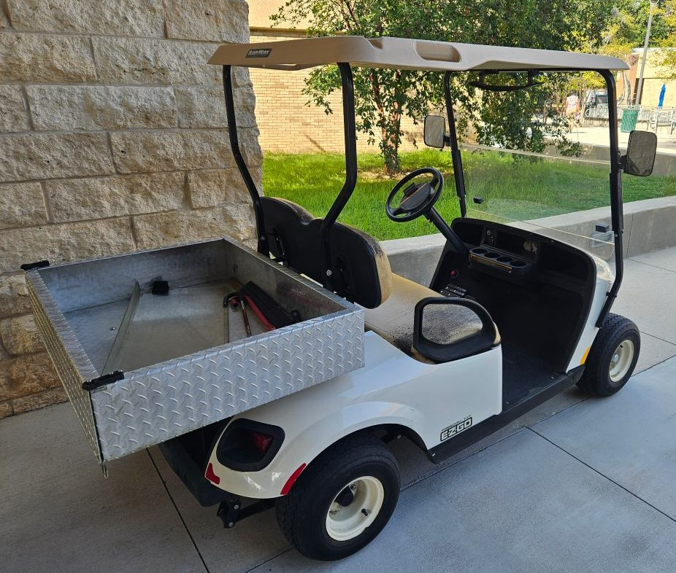
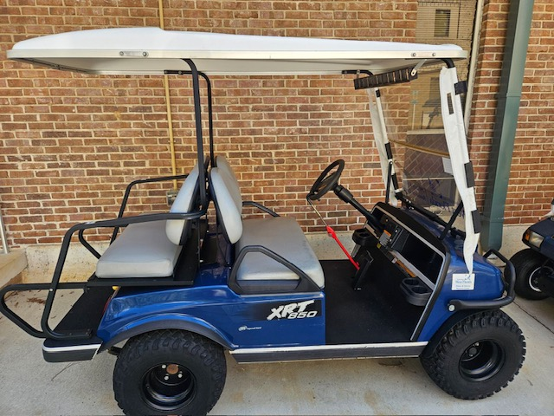
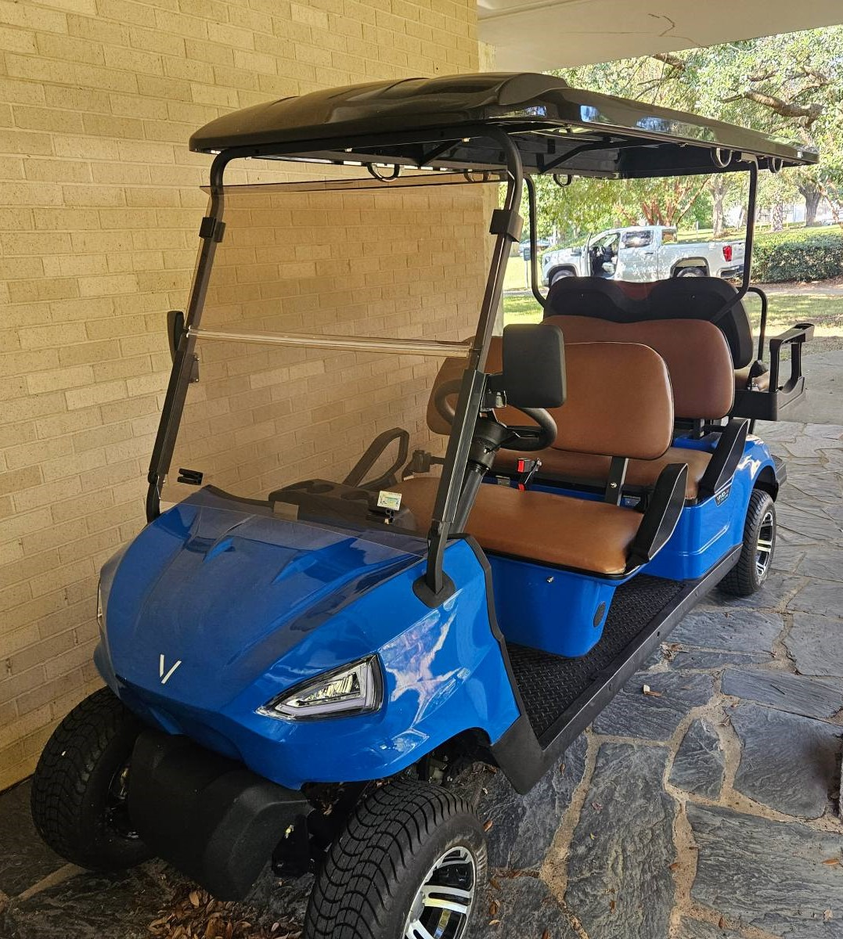
UWF Motorized Cart Safety
Non-licensed Vehicles
Motorized Carts are to be used only for official University business. All Motorized Carts must be operated safely on University property to reduce accidents, incidents, and injuries.
Notes:
Here are some different types of Carts. These are non-licensed vehicles. Note the hand rail and seating.

Slide 3
Definitions (University Policy ES-08.02-08/24)
Authorized Driver - an employee, including a student-employee, trustee, officer, agent, contractor, or approved volunteer authorized by the University to drive a University vehicle, including Motorized Carts.
Must have a valid driver license
Must be at least 18 years of age
Motorized Cart – a gas- or electric-motor vehicle designed and manufactured for recreational or work purposes that is not designed or used primarily for the transportation of persons or property on a street or highway.
Notes:
Some departments may not have the funds to retrofit.
Hand signals must be used in carts without turn signals

Slide 4
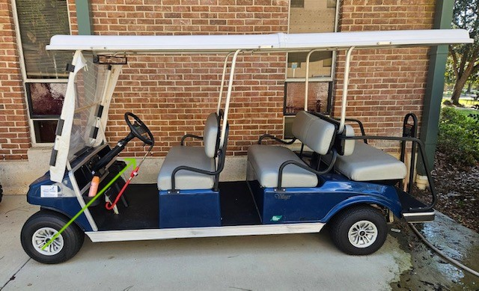
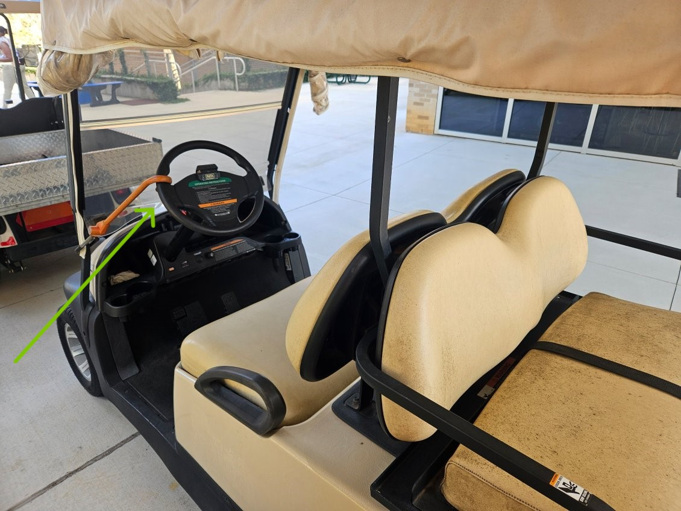
Equipment Requirements
A Motorized Cart that is used between sunrise and sunset on University property must have the following equipment:
  Rear-view mirror Red reflectors (front and rear)
  Brake lights Parking brake
  Turn signals Key ignition or power shutoff
  Steering column locking mechanism
Notes:
Some departments may not have the funds to retrofit.
Hand signals must be used in carts without turn signals

Slide 5
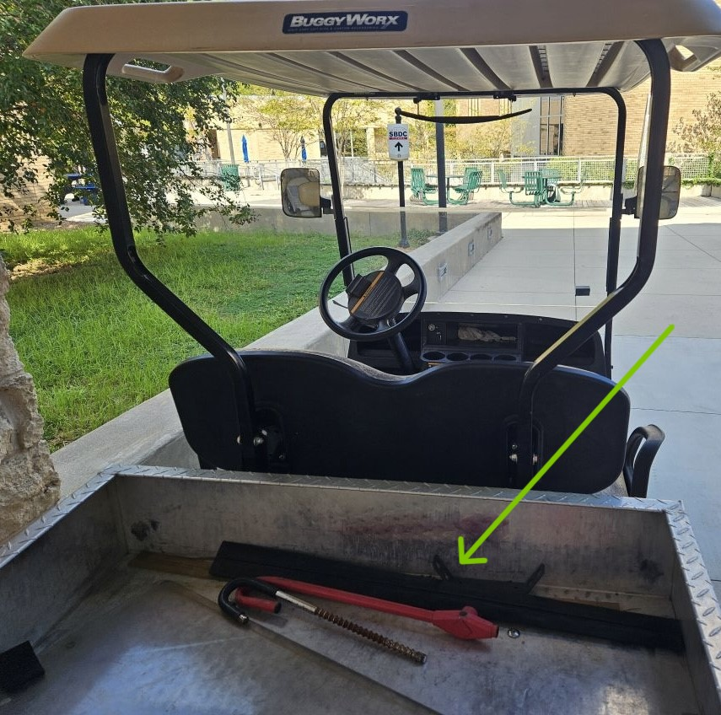
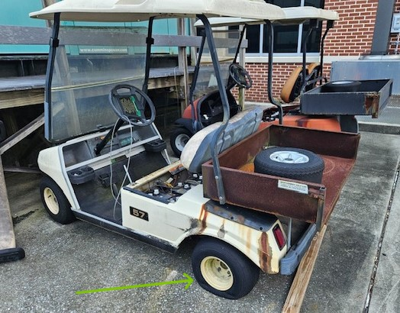
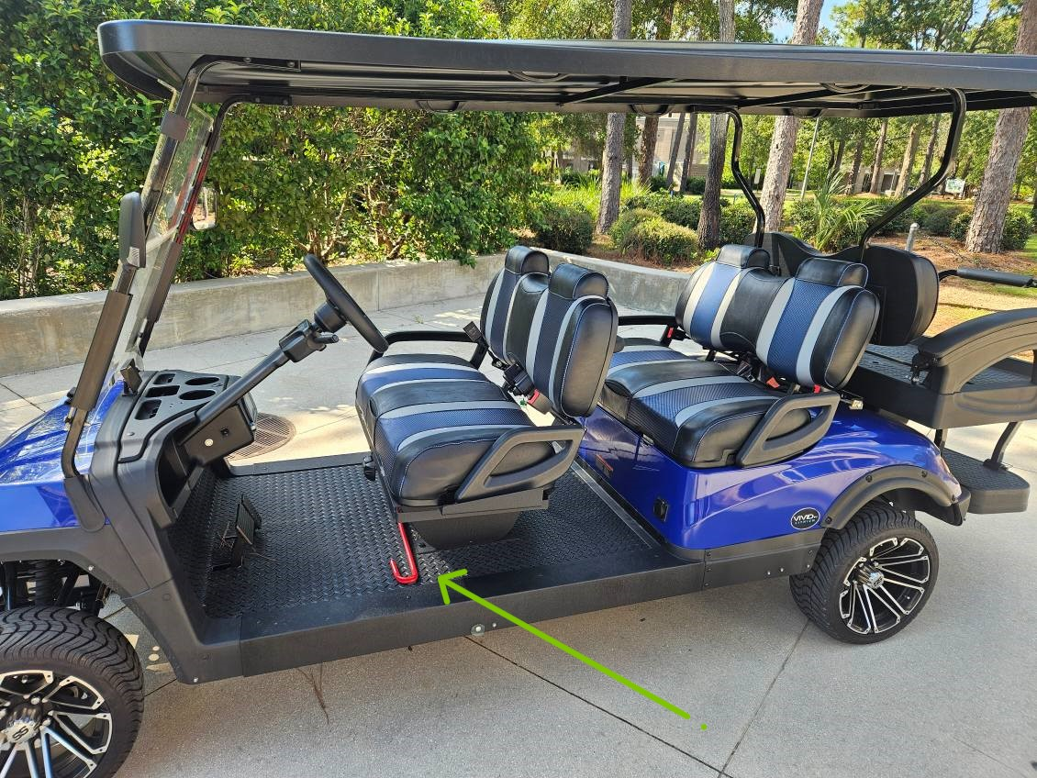
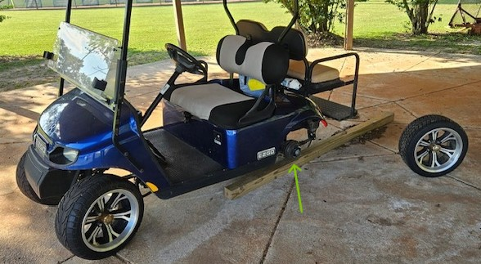
Equipment Requirements
In addition, the Motorized Cart must have efficient brakes, reliable steering, and safe tires (designed for specific types of driving surfaces).

Slide 6
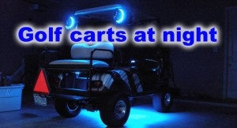
Equipment Requirements
Motorized Carts designated for use from sunset to sunrise (night-time) must also be outfitted with:
    Windshield
    Headlights
    Taillights

Slide 7
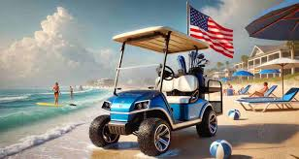
Motorized Cart Maintenance
        Ensure all components and safety features work and are maintained by an approved vendor per the service schedule.
        Keep carts clean and in use to extend their lifespan.
        Only authorized drivers may operate; no repairs or maintenance by drivers.
        Maintain detailed maintenance and repair records.
        Do not charge batteries indoors.
        Use GFI outlets only—no extension cords or surge protectors.
        Facilities Management may designate carts as surplus if deemed unusable.

Slide 8
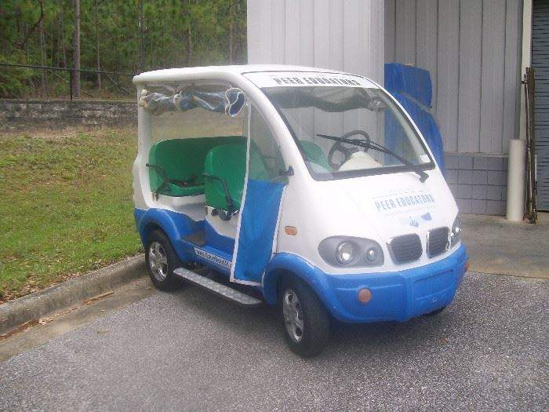
Registration Requirements
        All University-owned motorized carts must be registered with Parking and Transportation Services and marked with an ID number.
        Contact Parking Services at 850.473.7711.
        Registration is free, and Parking Services keeps a list of all registered carts.
Notes:
New decals will be available this fall.

Slide 9
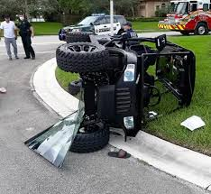
Insurance for Motorized Carts
University-owned motorized carts are insured for liability only, covering damage to persons and property, but not collision damage.
The owning department is responsible for any repairs needed for the motorized cart.
For departments interested in purchasing additional insurance coverage, please contact Pennie Sparks, Risk Manager, for a quote at psparks@uwf.edu or 850.474.2177.
ONLY AUTHORIZED DRIVERS ARE ELIGIBLE TO DRIVE UNIVERSITY-OWNED MOTORIZED CARTS!

Slide 10
Authorized Driver Requirements
          To be an Authorized Driver you must:
            Possess a valid driver license
            Be at least 18 years of age
            Adhere to the State of Florida motor vehicle laws
          Read and understand University Policy ES-08.02-08/24, Motorized Cart Safety
          Take the online training class “Motorized Cart Safety” on Scoop
          Complete the quiz with a passing score, and
          Sign the Motorized Cart Safety Acknowledgement Form annually

Slide 11
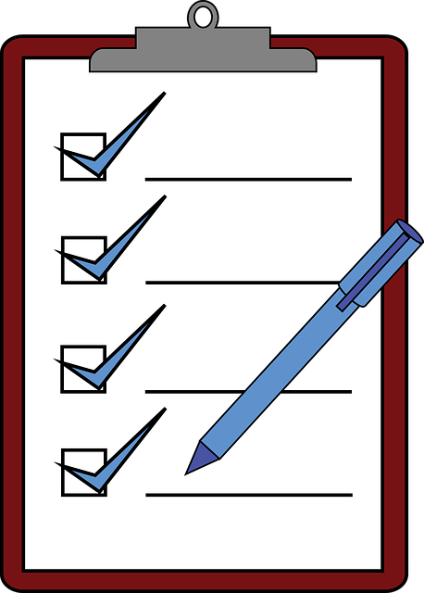
Safety Inspection
        Departments using University-owned motorized carts must maintain and document safety inspections.
        Get the inspection form from the UWF EH&S webpage (uwf.edu/envhs).
        Inspections should cover all safety features and mechanical systems of each cart.
        Brakes
        Lights (headlights and taillights)
        Turn signals, if applicable
        Tires
        Batteries
        Windshield Wipers
        Mirror
        Road Test
        Immediately report any problems to your supervisor.

Slide 12
Department Responsibility
        Confirm motorized carts are used for official university business.
        Document and maintain a thorough safety inspection.
        Ensure security measures for motorized carts.
        Verify drivers have valid licenses, completed EH&S training, and submitted the safety acknowledgment form.
        Retain the safety acknowledgment form for each driver.
        Train drivers on accident procedures.

Slide 13
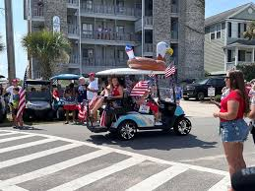
Authorized Driver Responsibilities
Pedestrians always have the right-of-way.
Authorized drivers must be cautious at crosswalks, as motorized carts do not have this right.
Motorized carts can be used off-street on university grounds, sidewalks, and roadways.
Modifying a cart’s speed governor (speed regulator) is prohibited and violates federal law.
Notes:
A Cart is prohibited from being used on the roadways of the campus except when crossing from one side of the street to the other or when utilizing a roadway where no other adequate sidewalk exists. In most cases, sidewalks are to be used and right-of-way is to be rendered to all pedestrians. Note: Operator is to use due caution at crosswalks. A Cart using pedestrian crosswalks does not have the right-of-way.
Pedestrians include anyone who may be walking, skating, skate boarding, bicycling, or those in wheelchairs.
•Avoid narrow sidewalks
•Stop & sound horn before proceeding through blind intersections or around blind corners.

Slide 14
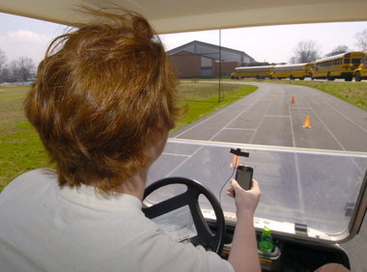
Authorized Driver Responsibilities
        The Authorized Driver must report any accidents immediately to the University Police, EH&S and supervisor.
        Notify supervisor immediately if license has expired, been suspended or revoked.
Use of cell phones, headphones, earbuds, smoking, or vaping while operating a Motorized Cart is prohibited.
Avoid any activities that distract you from driving
Notes:
Accidents must be reported immediately.

Slide 15
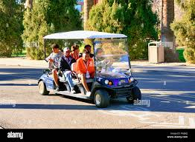
Operational Safety
Do not drive through buildings, breezeways, covered walkways, or landscaped areas.
Exercise caution around disabled individuals with potential limitations.
Do not exceed the recommended load capacity; occupancy is limited to available seats.
All occupants must stay seated and keep limbs inside the cart.Wear seatbelts if available.
Secure all equipment inside the cart; no protrusions unless marked with flagging.
Notes:
Watch for overhangs, you or the Cart could be injured/damaged.

Slide 16
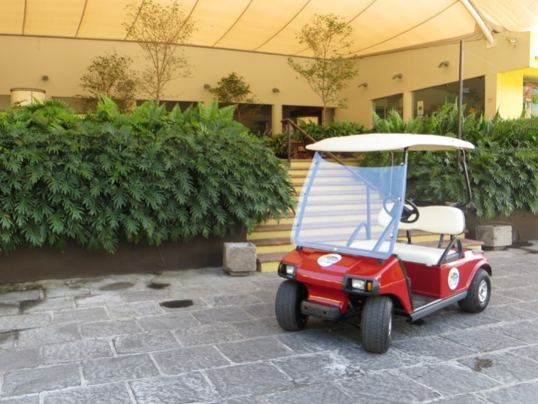
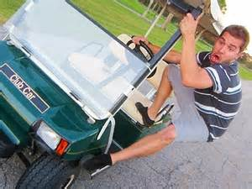
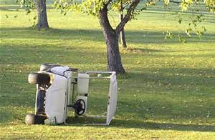
Operational Safety
        Operators are responsible for ignition keys; do not leave them unattended.
        Do not park in reserved spaces, walkways, doorways, or ADA accessible areas.
        Ensure emergency vehicle pathways remain clear.
        Avoid using motorized carts in inclement weather.
        Sudden stops or direction changes may lead to loss of control.
        Trailers pulled by motorized carts must have a red reflector strip at the rear.

Slide 17
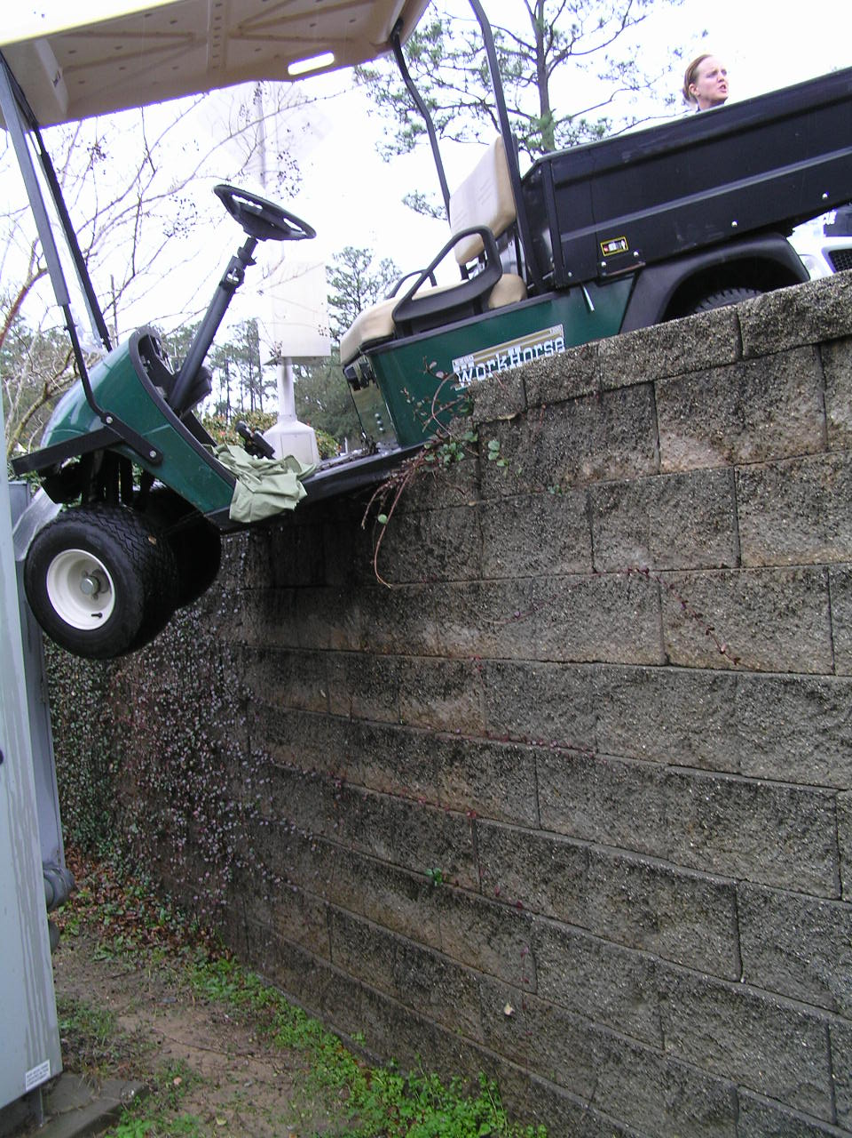
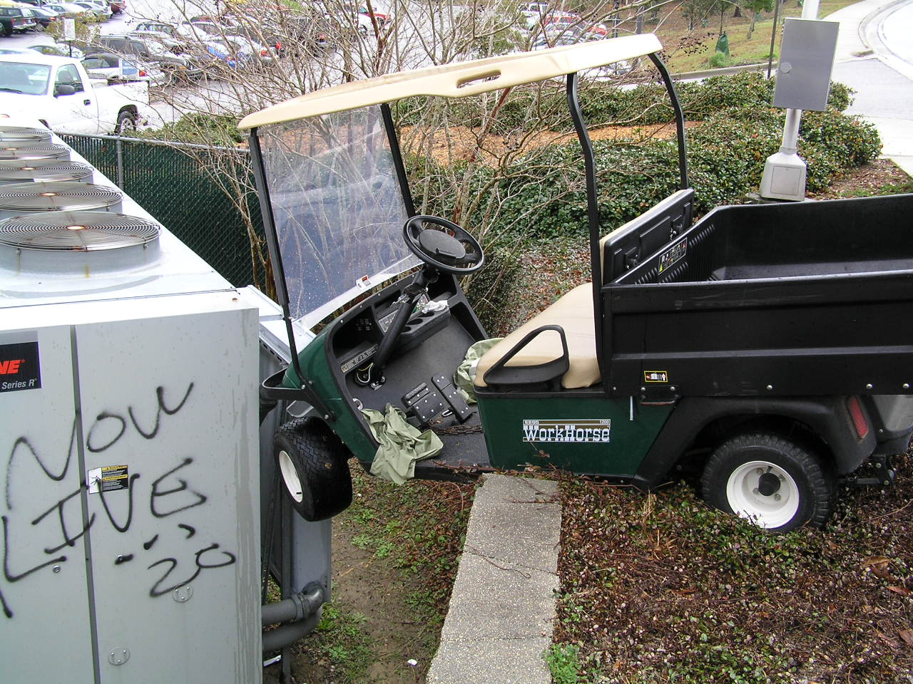
UWF Martin Hall Accident
UWF employee was distracted and to avoid a collision with a pedestrian swerved off the sidewalk and almost went over the retaining wall.
No injuries were reported with this incident.
This incident could have been avoided if due caution and pedestrian right-of-way was given for the crosswalk area.

Slide 18

UWF Motorized Cart Safety Training
Questions?
UWF Environmental
Health and Safety
850.474.2525

