Slide 1

Motorized Cart Safety Course
Presented by the Office of Environmental Health and Safety

Slide 2
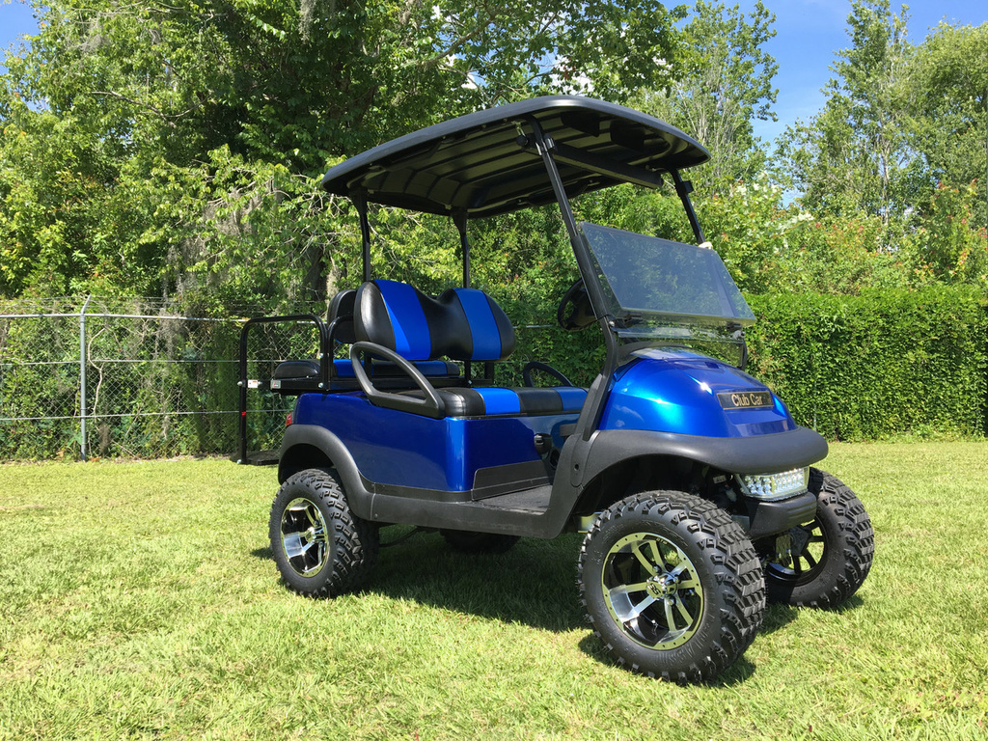
UWF Motorized Cart Safety
Non-Licensed Vehicles
Motorized Carts are to be used only for official University business. All Motorized Carts must be operated safely on University property to reduce accidents, incidents, and injuries.

Slide 3
Definitions (University Police ES-08.02-08/24)
Authorized Driver, an employee, including a student-employee, trustee, officer, agent, contractor, or approved volunteer authorized by the University to drive a University vehicle, including Motorized Carts.
  Must have a valid driver license
  Must be at least 18 years of age
Motorized Cart, a gas- or electric-motor vehicle designed and manufactured for recreational or work purposes that is not designed or used primarily for the transportation of persons or property on a street or highway.

Slide 4
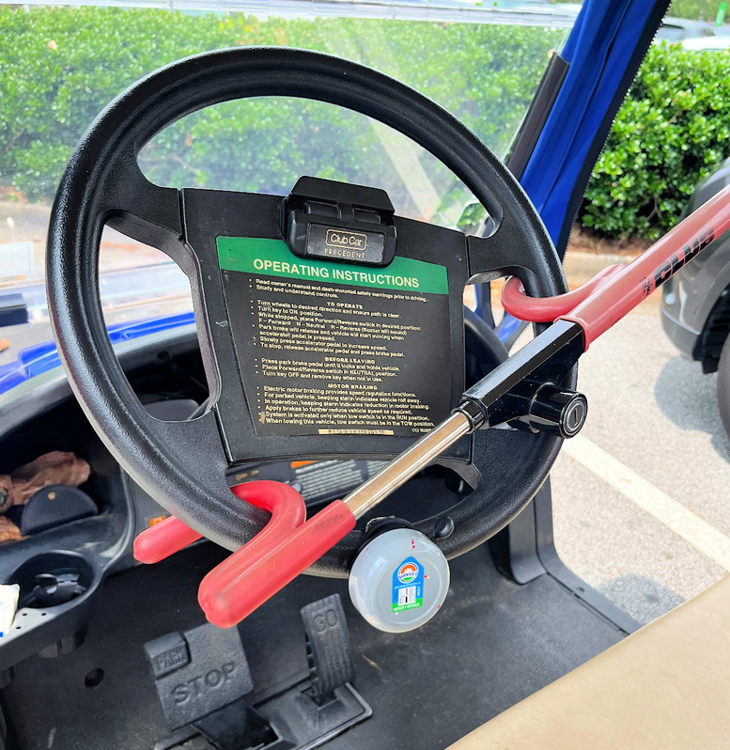
Equipment Requirements
A Motorized Cart that is used between sunrise and sunset on University property must have the following equipment:
  Rear-view mirror
  Red reflectors (front and rear)
  Brake lights
  Parking brake
  Turn signals
  Key ignition or power shutoff
  Steering column locking mechanism

Slide 5
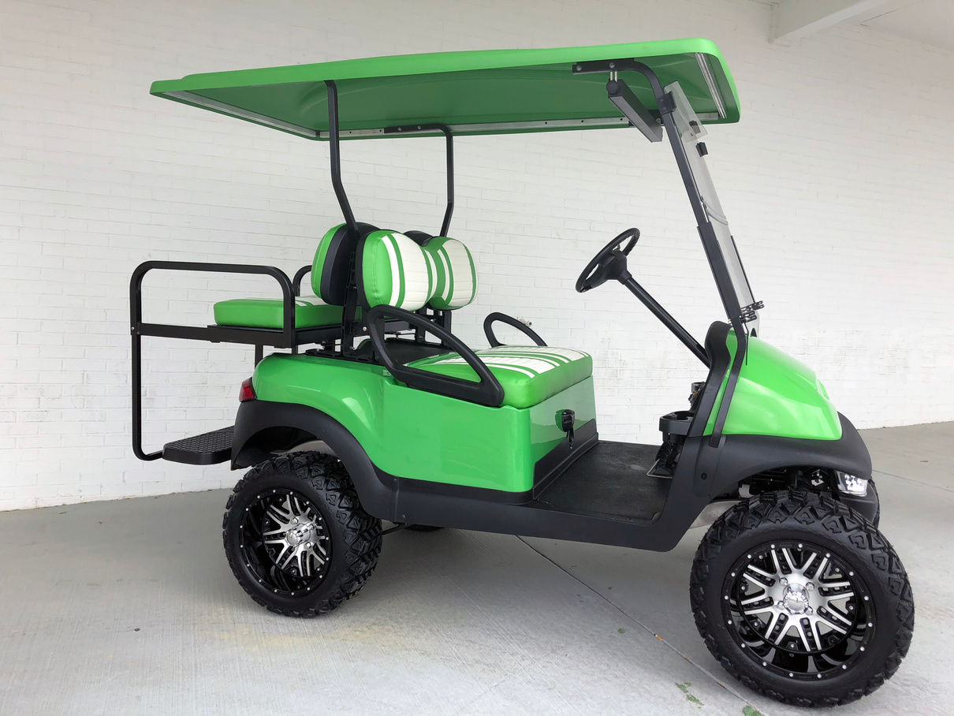



Equipment Requirements
In addition, the Motorized Cart must have efficient brakes, reliable steering, and safe tires (designed for specific types of driving surfaces).

Slide 6
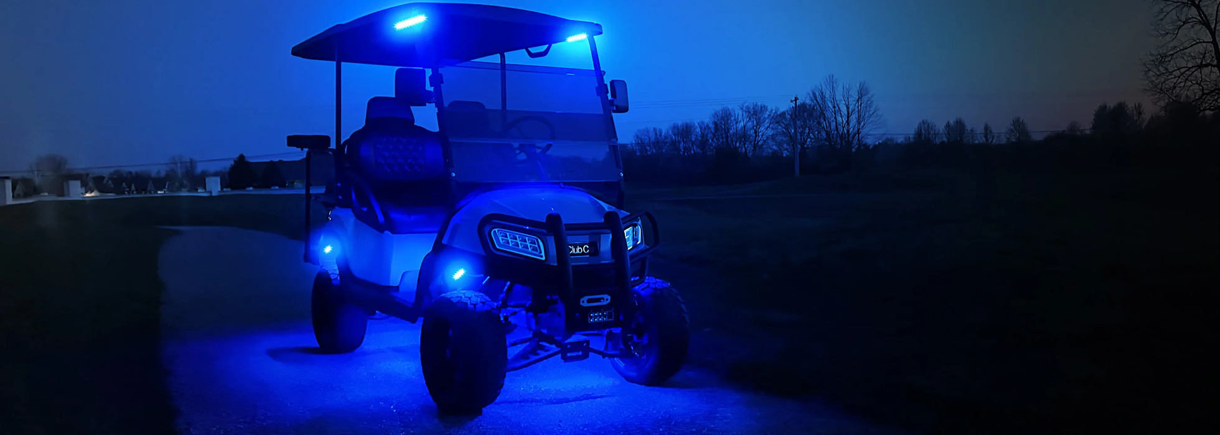
Equipment Requirements
Motorized Carts designated for use from sunset to sunrise (night-time) must also be outfitted with:
  Windshield
  Headlights
  Taillights

Slide 7
Motorized Cart Maintenance
  Ensure all components and safety features work and are maintained by an approved vendor per the service schedule.
  Keep carts clean and in use to extend their lifespan.
  Only authorized drivers may operate; no repairs or maintenance by
  drivers.
  Maintain detailed maintenance and repair records.
  Do not charge batteries indoors.
  Use GFI outlets only—no extension cords or surge protectors.
  Facilities Management may designate carts as surplus if deemed unusable.

Slide 8
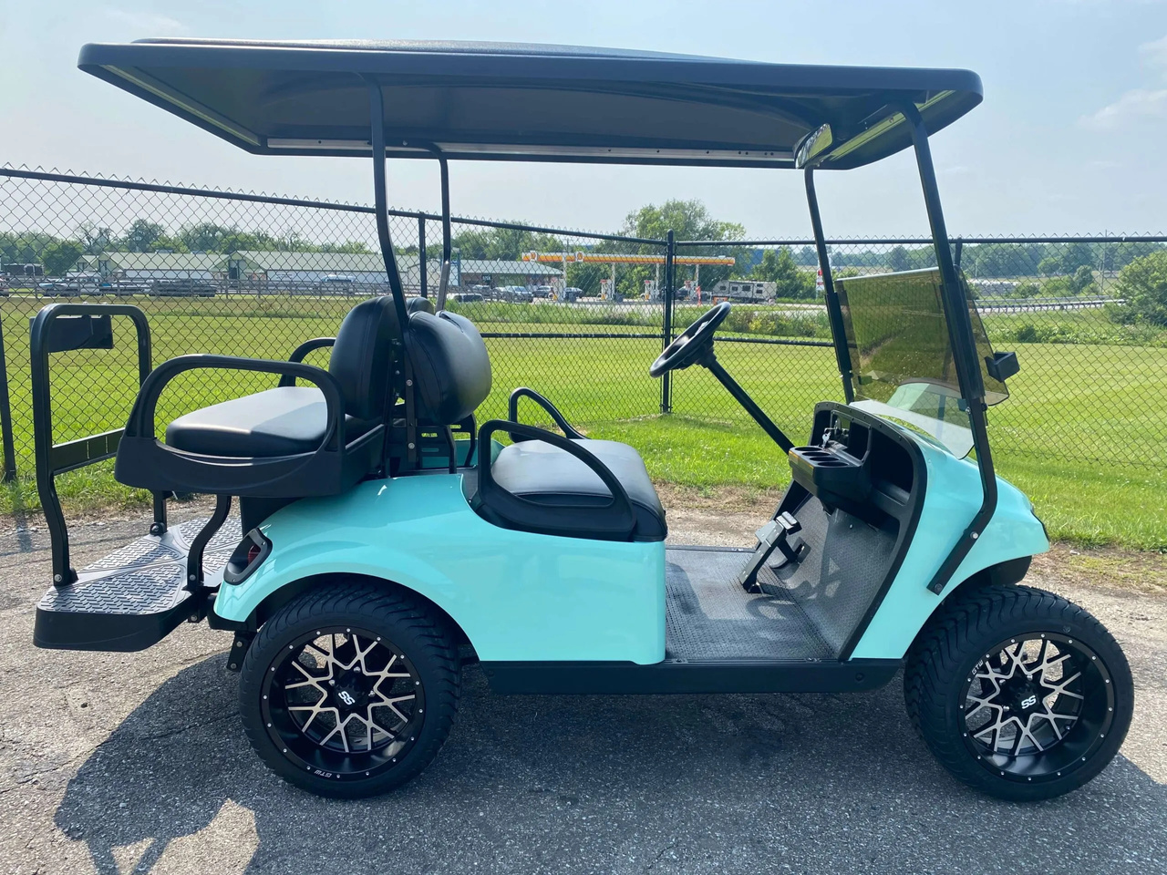
Registration Requirements
  All University-owned motorized carts must be registered with Parking and Transportation Services and marked with an ID number.
  Registration is free, and Parking Services keeps a list of all registered carts.
Contact UWF Parking and Transportation Services at 850.473.7711.

Slide 9
Insurance for Motorized Carts
  University-owned motorized carts are insured for liability only, covering damage to persons and property, but not collision damage.
  The owning department is responsible for any repairs needed for the motorized cart.
  For departments interested in purchasing additional insurance coverage, please contact Pennie Sparks, Risk Manager, for a quote at psparks@uwf.edu or 850.474.2177.
ONLY AUTHORIZED DRIVERS ARE ELIGIBLE TO DRIVE
UNIVERSITY-OWNED MOTORIZED CARTS!

Slide 10
Authorized Driver Requirements
To be an Authorized Driver you must:
  Possess a valid driver license
  Be at least 18 years of age
  Adhere to the State of Florida motor vehicle laws
  Read and understand University Policy ES-08.02-08/24, Motorized Cart Safety
  Take the online training class “Motorized Cart Safety” on Scoop
  Complete the quiz with a passing score, and
  Sign the Motorized Cart Safety Acknowledgement Form annually

Slide 11

Safety Inspection
  Departments using University-owned motorized carts must maintain and document safety inspections.
  Get the inspection form from the UWF EH&S webpage (uwf.edu/envhs).
  Inspections should cover all safety features and mechanical systems of each cart.
  Brakes
  Lights (headlights and taillights)
  Turn signals, if applicable
  Tires
  Batteries
  Windshield Wipers
  Mirror
  Road Test
Immediately report any problems to your supervisor.

Slide 12
Department Responsibility
  Confirm motorized carts are used for official university business.
  Document and maintain a thorough safety inspection.
  Ensure security measures for motorized carts.
  Verify drivers have valid licenses, completed EH&S training, and submitted the safety acknowledgment form.
  Retain the safety acknowledgment form for each driver.
  Train drivers on accident procedures.

Slide 13
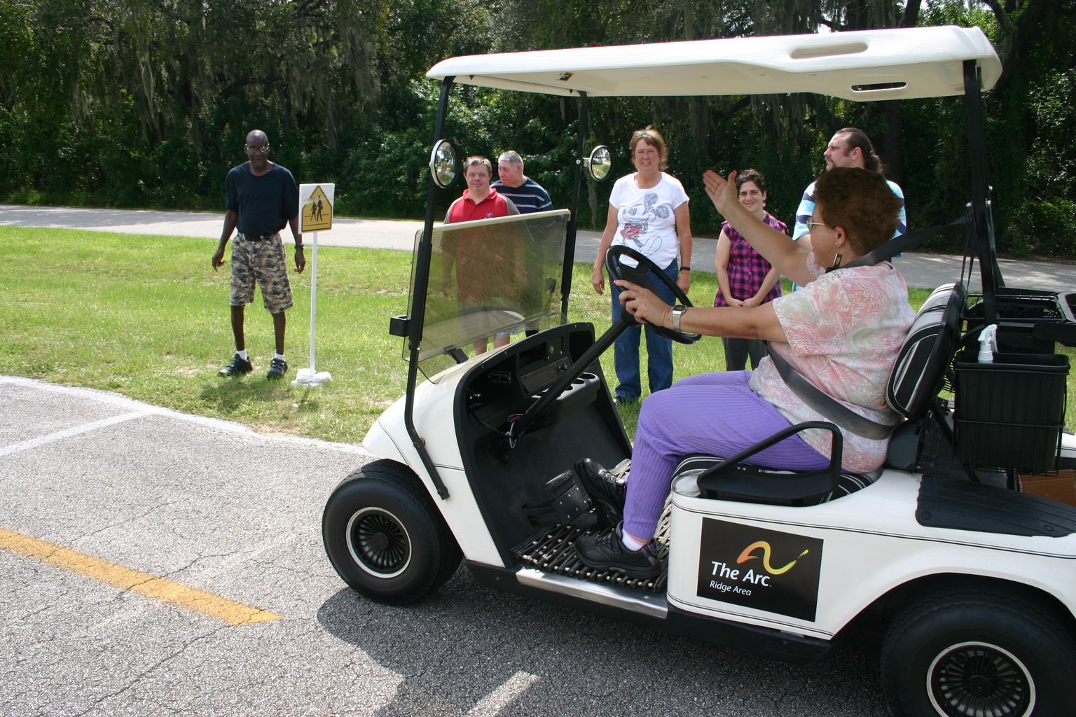
Authorized Driver Responsibilities
  Pedestrians always have the right-of-way.
  Authorized drivers must be cautious at crosswalks, as motorized carts do not have this right.
  Motorized carts can be used off-street on university grounds, sidewalks, and roadways.
  Modifying a cart’s speed governor (speed regulator) is prohibited and violates federal law.

Slide 14


Authorized Driver Responsibilities
  The Authorized Driver must report any accidents immediately to the University Police, EH&S and supervisor.
  Notify supervisor immediately if license has expired, been suspended or revoked.
  Use of cell phones, headphones, earbuds, smoking, or vaping while operating a Motorized Cart is prohibited.
Avoid any activities that distract you from driving

Slide 15
Operational Safety
  Do not drive through buildings, breezeways, covered walkways, or landscaped areas.
  Exercise caution around disabled individuals with potential limitations.
  Do not exceed the recommended load capacity; occupancy is limited to available seats.
  All occupants must stay seated and keep limbs inside the cart. Wear seatbelts if available.
  Secure all equipment inside the cart; no protrusions unless marked with flagging.

Slide 16
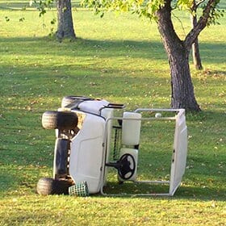
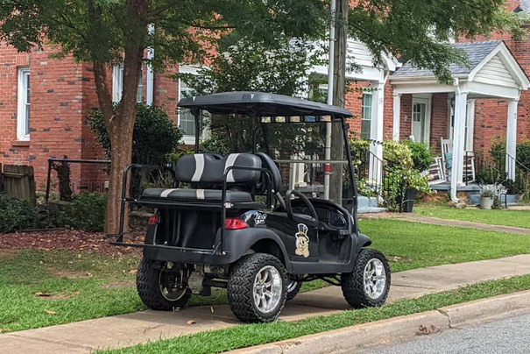
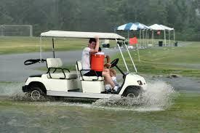
Operational Safety
  Operators are responsible for ignition keys; do not leave them unattended.
  Do not park in reserved spaces, walkways, doorways, or ADA accessible areas.
  Ensure emergency vehicle pathways remain clear.
  Avoid using motorized carts in inclement weather.
  Sudden stops or direction changes may lead to loss of control.
  Trailers pulled by motorized carts must have a red reflector strip at the rear.

Slide 17
UWF Martin Hall Accident
  UWF employee was distracted and to avoid a collision with a pedestrian swerved off the sidewalk and almost went over the retaining wall.
  No injuries were reported with this incident.
  This incident could have been avoided if due caution and pedestrian right-of-way was given for the crosswalk area.

Slide 18
UWF Motorized Cart Safety Training
Questions?
UWF Environmental Health and Safety
850.474.2525

